Slide 1
Propositional Logic
CS161
Prof. Guy Van den Broeck

Slide 2
What are Logic-Based Systems?
Structure: Reasoning ‘engine’
Knowledge base: declarative sentences in a knowledge-representation language
Dominant paradigm 1958-1988
AI proved a new theorem in lattice theory!
Robotics, computer vision, etc., all based on pure logic.
Observations - Queries
Reasoning Engine
Knowledge base (KB)
Conclusions (Deductions)

Slide 3
Why logic?
Specification α and implementation β
Show that β entails α using SAT solver
The implementation is “correct”
Hardware verification
CPU computes addition correctly
Software verification (often SMT – first-order)
Windows driver does not write to unallocated memory
Cryptography
Planning

Slide 4
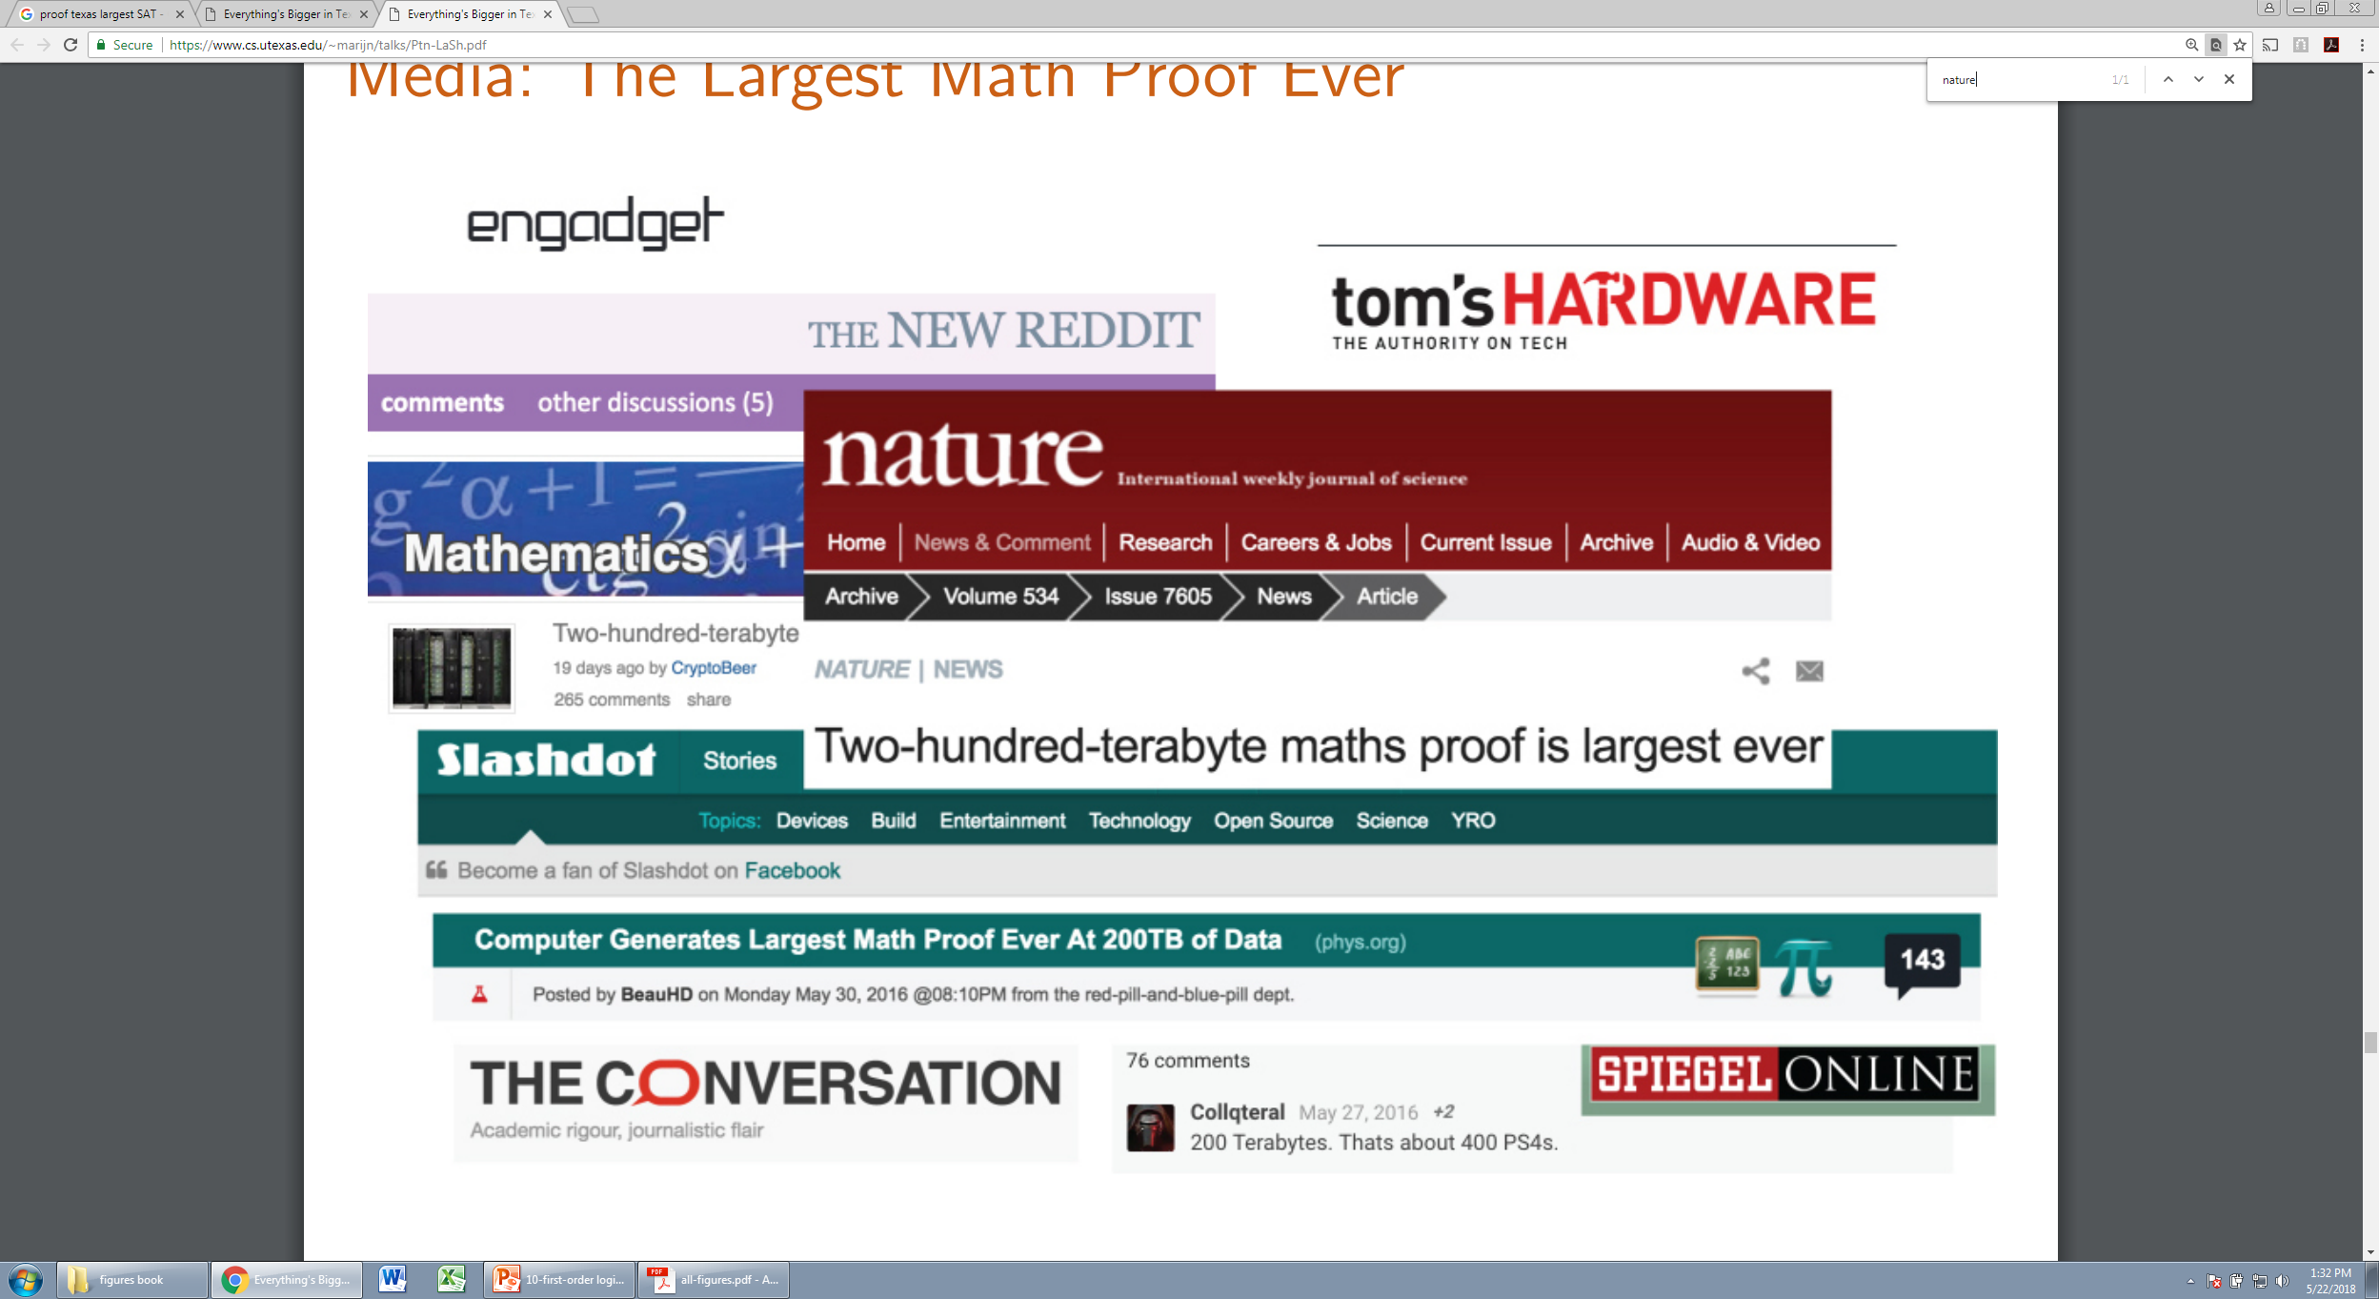
Why logic?
(after Marijn J.H. Heule)

Slide 5
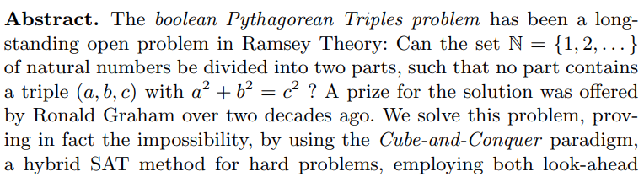
Why logic?
There are more than 10^(2,300) ways to color the integers up to 7,825.
(after Marijn J.H. Heule)

Slide 6
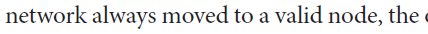
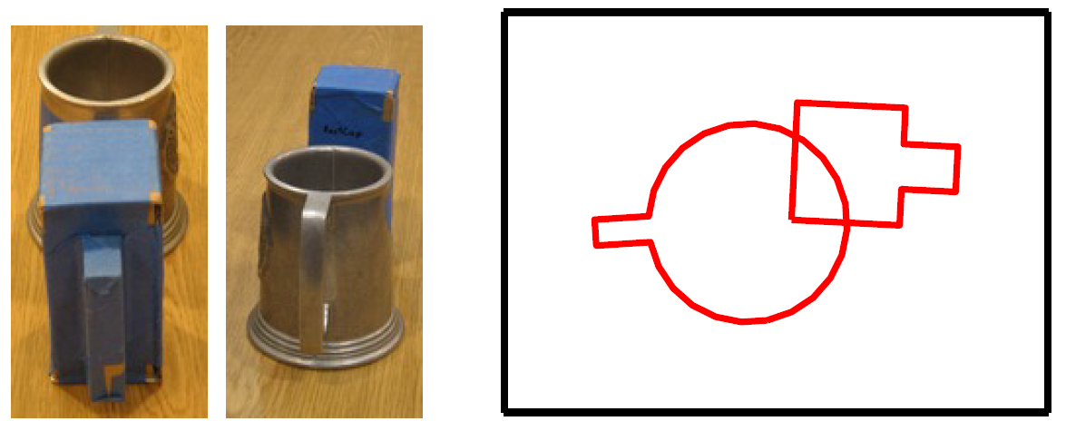
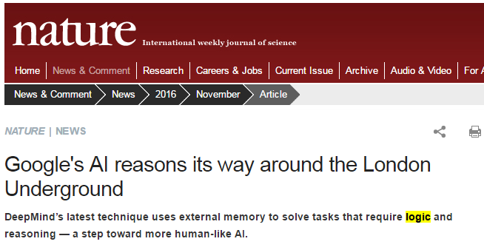
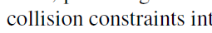
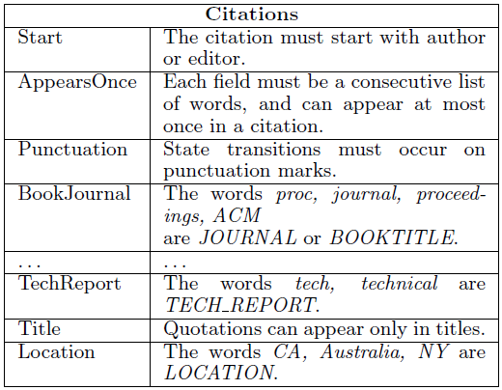
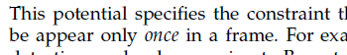
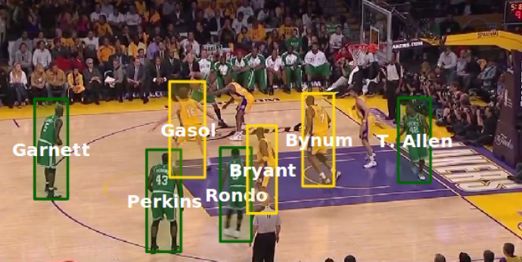
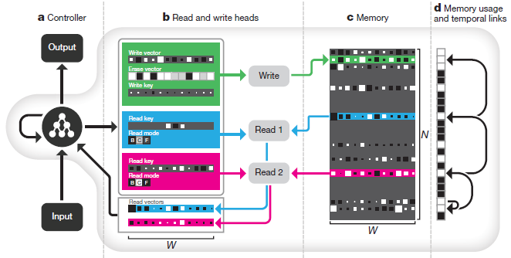
Today: Role of logic in ML
Deep Learning
Everywhere!
To express knowledge about the world.
Vision
NLP

Slide 7

Wumpus World
Grid world
Pit causes breeze in adjacent cells
Wumpus causes stench in adjacent cells
Find the gold

Slide 8
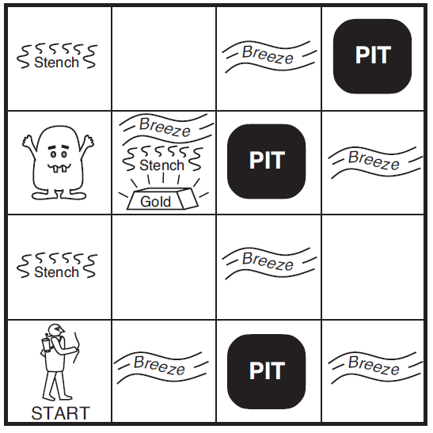
Wumpus World

Slide 9
Wumpus World: Discussion
Overcome ignorance about the world by reasoning
Conclusions guaranteed to be correct
Inferred new knowledge
from observations
from lack of observations
at different point in time

Slide 10
Syntax: What am I allowed to write?
x+5=y or x5y+=?
Variables/propositions: X, Y, Z, Rain, Sun
Grammar of sentences … (see next)

Slide 11
Syntax of Propositional Logic
A logical formula or sentence is either
an atomic sentence (X,Y,Z), called atom, or
a compound sentence of the form where p and q are sentences.
The operators ¬, ∧, ∨, →, ← and ↔ are logical connectives.
Atoms and their negation are called literals (¬X,X)
¬p | “not p” | negation of pp
p∧q | “p and q” | conjunction of p and q
p∨q | “p or q” | disjunction of p and q
p→q | “p implies q” | implication of q from p
p←q | “p if q” | implication of p from q
p↔q | “p if and only if q” | equivalence of p and q

Slide 12
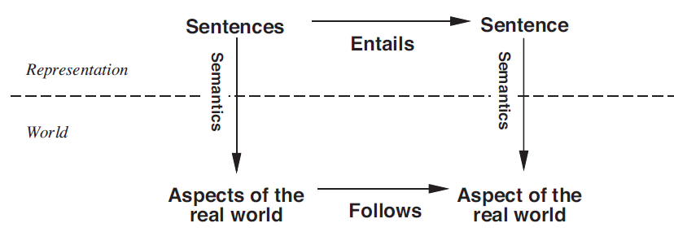
Semantics

Slide 13
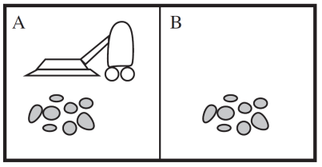

Worlds or Truth Assignments
1
2
9
10
3
4
11
12
5
6
13
14
7
8
15
16

Slide 14
Sentence ↔️ World
Relationship between sentence α and world ω
Sentence α is true at world ω:
ω ⊨ α “ω satisfies α” “α holds in ω”
Sentence α is false at world ω
ω ⊭ α

Slide 15
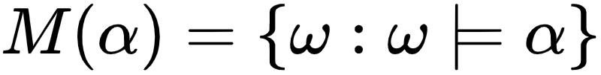
Semantics: what does a sentence say about the real world?
Knowledge/meaning is a set of worlds
Meaning of α is that “the set of worlds ω where α is true” are the only ones possible
These worlds are the models of α

Slide 16

Variables and Sentences
Variables: LR, RR, LD, RD
Exactly one robot: sentences α

Slide 17
Meaning/Semantics
1
2
9
10
3
4
11
12
5
6
13
14
7
8
15
16

Slide 18
More sentences
Dirt and robot cannot co-exist

Slide 19
Meaning/Semantics
1
2
9
10
3
4
11
12
5
6
13
14
7
8
15
16

Slide 20
More sentences
The robot is in the left room

Slide 21
Meaning/Semantics
1
2
9
10
3
4
11
12
5
6
13
14
7
8
15
16

Slide 22
Formal Semantics + Algorithm
How to define ω ⊨ α?
Is it circular?
What is an algorithm to decide ω ⊨ α
What is its complexity?

Slide 23
Truth Tables
p | q | ¬p | p∧q | p∨q | p←q | p→q | p↔q
true | true | false | true | true | true | true | true
true | false | false | false | true | true | false | false
false | true | true | false | true | false | true | false
false | false | true | false | false | true | true | true

Slide 24
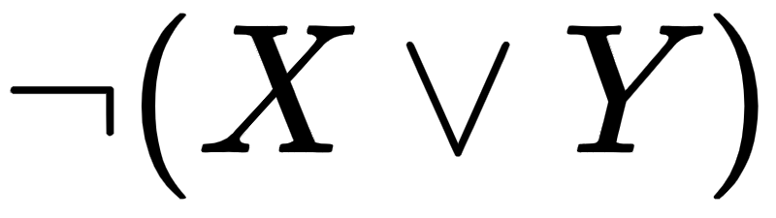
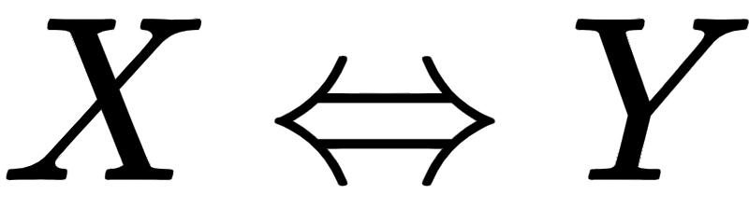

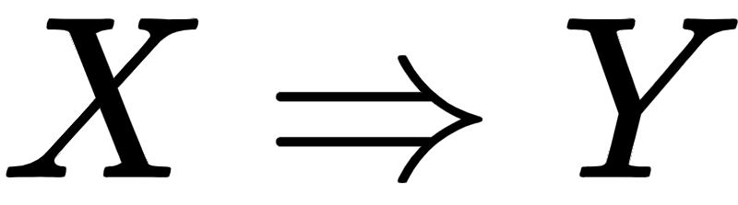
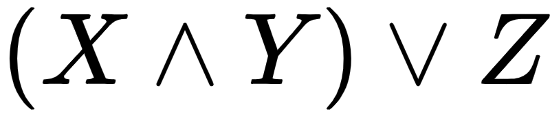

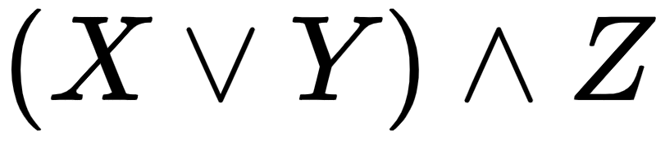
Syntax Conversion Rules

Slide 25
Modeling: Wumpus World
 | P1
P4 | B | P2
 | P3

Slide 26
Modeling: Course Requirements
assignments
models
L | K | P | A
0 | 0 | 0 | 0
0 | 0 | 0 | 1
0 | 0 | 1 | 0
0 | 0 | 1 | 1
0 | 1 | 0 | 0
0 | 1 | 0 | 1
0 | 1 | 1 | 0
0 | 1 | 1 | 1
1 | 0 | 0 | 0
1 | 0 | 0 | 1
1 | 0 | 1 | 0
1 | 0 | 1 | 1
1 | 1 | 0 | 0
1 | 1 | 0 | 1
1 | 1 | 1 | 0
1 | 1 | 1 | 1
L | K | P | A
0 | 0 | 0 | 0
0 | 0 | 0 | 1
0 | 0 | 1 | 0
0 | 0 | 1 | 1
0 | 1 | 0 | 0
0 | 1 | 0 | 1
0 | 1 | 1 | 0
0 | 1 | 1 | 1
1 | 0 | 0 | 0
1 | 0 | 0 | 1
1 | 0 | 1 | 0
1 | 0 | 1 | 1
1 | 1 | 0 | 0
1 | 1 | 0 | 1
1 | 1 | 1 | 0
1 | 1 | 1 | 1
Must take at least one of Probability or Logic.
Probability is a prerequisite for AI.
The prerequisites for KR is either AI or Logic.
7 out of 16 instantiations are impossible

Slide 27



Logical Modeling
assignments
models
L | K | P | A
0 | 0 | 0 | 0
0 | 0 | 0 | 1
0 | 0 | 1 | 0
0 | 0 | 1 | 1
0 | 1 | 0 | 0
0 | 1 | 0 | 1
0 | 1 | 1 | 0
0 | 1 | 1 | 1
1 | 0 | 0 | 0
1 | 0 | 0 | 1
1 | 0 | 1 | 0
1 | 0 | 1 | 1
1 | 1 | 0 | 0
1 | 1 | 0 | 1
1 | 1 | 1 | 0
1 | 1 | 1 | 1
L | K | P | A
0 | 0 | 0 | 0
0 | 0 | 0 | 1
0 | 0 | 1 | 0
0 | 0 | 1 | 1
0 | 1 | 0 | 0
0 | 1 | 0 | 1
0 | 1 | 1 | 0
0 | 1 | 1 | 1
1 | 0 | 0 | 0
1 | 0 | 0 | 1
1 | 0 | 1 | 0
1 | 0 | 1 | 1
1 | 1 | 0 | 0
1 | 1 | 0 | 1
1 | 1 | 1 | 0
1 | 1 | 1 | 1
7 out of 16 instantiations are impossible

Slide 28
Properties of Sentences

Slide 29
Properties of Sentences
α is valid: holds at every world (it is a tautology)
α is inconsistent (UNSAT): holds at no world
α is satisfiable (SAT): not inconsistent

Slide 30
Relationships Between Sentences

Slide 31
Relationships between Sentences
α entails β: wherever α holds, β also holds
α and β are equivalent: they hold at exactly the same worlds
α and β are mutually exclusive: they never hold in the same world

Slide 32
Express these concepts
Validity, consistence, entailment, equivalence, mutual exclusivity:
In terms of the models M(.)
In terms of truth ω ⊨ α

Slide 33
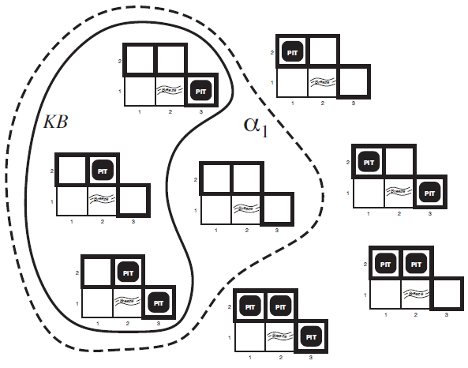
Question α₁: There is no pit in (1,2)?

Slide 34
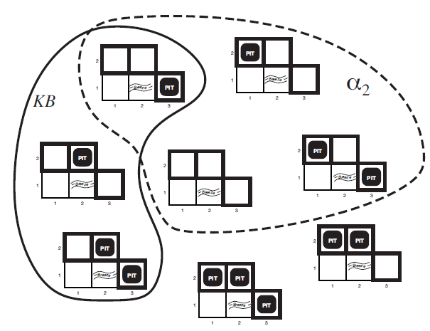
Question α₂: There is no pit in (2,2)?

Slide 35
Reductions
Validity to SAT?
Entailment to SAT?
(refutation theorem)
Entailment to Validity?
(deduction theorem)

Slide 36
What happens if we extend the KB?
Monotonicity of Logic!

Slide 37
Normal Forms
Clause: disjunction of literals
A v B v ¬C v ¬D
¬C
False
Conjunctive normal form (CNF): Conjunction of clauses
Dual: Disjunctive normal form (DNF): Disjunction of conjunctions of literals
Definite clauses (1 +literal), Horn clauses (≤1 +literal)

Slide 38
Complexity
What is the complexity of
SAT?
CNF?
DNF?
Validity?
CNF?
DNF?
Why do we care about normal forms?
Required by inference tools and algorithms
Different tractability properties

Slide 39
Propositional Reasoning

Slide 40
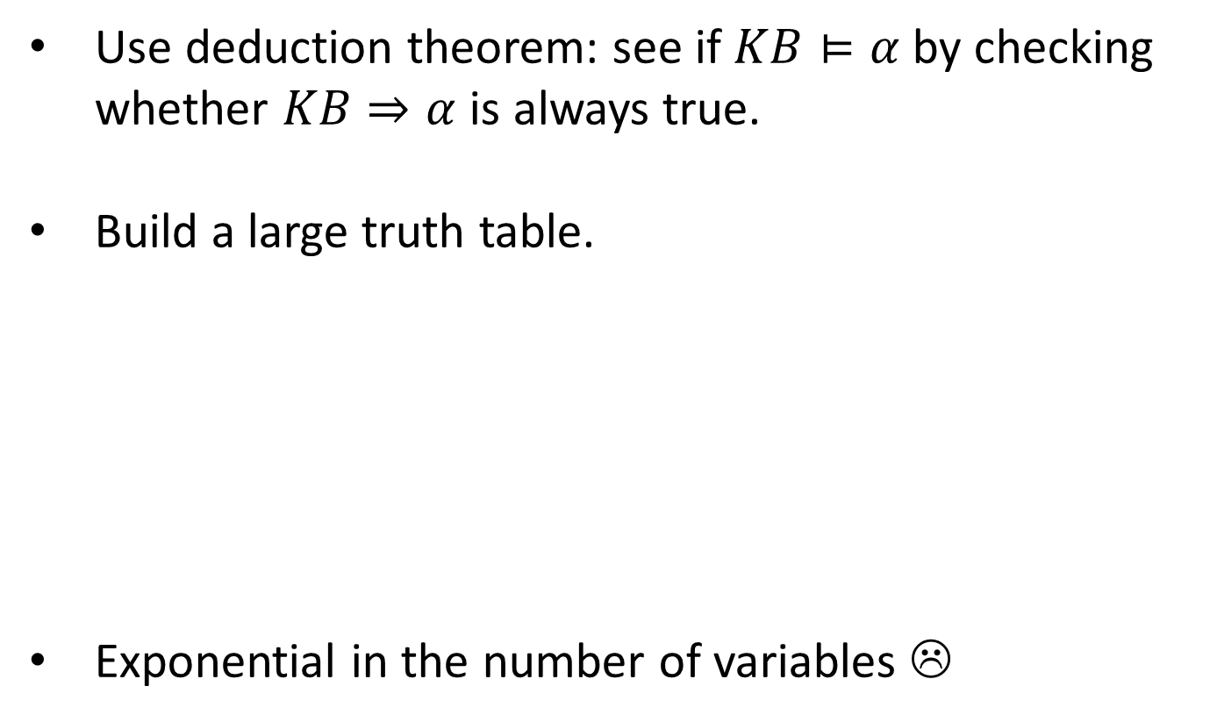
Inference by Enumerating Models
p | q | ¬p | p∧q | p∨q | p←q | p→q | p↔q
true | true | false | true | true | true | true | true
true | false | false | false | true | true | false | false
false | true | true | false | true | false | true | false
false | false | true | false | false | true | true | true

Slide 41
Inference by Resolution
Refutation Proofs

Slide 42
DPLL Search
Davis, Putnam, Logemann, Loveland [Davis’60, ’62]
// basic DPLL:
Function SAT(F):
if F = false then return 0
if F = true then return 1
select a variable x, return
SAT(F_{X=0}) OR SAT(F_{X=1})
F ≡ (F_{X=0} Λ ¬X)∨ (F_{X=1} Λ X)
Shannon decomposition
Shannon’s expansion
Boole’s expansion
Case analysis

Slide 43
Basic DPLL
F: (x∨y) ∧ (x∨¬u∨w) ∧ (¬x∨¬u∨w∨z)
x
// basic DPLL:
Function SAT(F):
if F = false then return 0
if F = true then return 1
select a variable x, return
SAT(F_{X=0}) OR SAT(F_{X=1})
1
0
¬u∨w∨z
y∧(¬u∨w)
z
y
1
0
1
0
¬u∨w
¬u∨w
1
u
u
0
Obviously many ways to improve
Stop early
Choose variable
Choose value
Propagate
Cache
Etc.
1
0
1
0
w
w
w
1
w
1
1
0
1
0
1
0
1
0
Notes:
Uniform distribution divided by two
Say that the computation can be done similarly

Slide 44
Unit Resolution/Unit Propagation
X ∨ Z
X
¬Y ∨ Z
Y ∨ ¬X
Propagating a unit clause (literal) either
removes a clause, or
removes literal from a clause (potentially creating new unit clauses)
Cheap and worthwhile operation in between DPLL search!

